Slide 1

Case study : Tesco
Presented By: Akshay Agarwal- 130040027 Rishi Shah- 131030002
Sameer Chourasia- 130020091 Suhani Gupta- 130010026

Slide 2
Company Profile
Tesco PLC is a British multinational grocery and general merchandise retailer headquartered in Cheshunt,Hertfordshire, England, United Kingdom.
3rd largest retailer in the world measured by profits
2nd largest retailer in the world measured by revenues.
Has stores in 12 countries across Asia and Europe and is the grocery market leader in the UK, Ireland, Hungary, Malaysia, and Thailand.
Listed on the London Stock Exchange.
Market capitalization of approximately £18.1 billion
28th-largest of any company with a primary listing on the London Stock Exchange
http://www.tescoplc.com

Slide 3
Subsidiaries of TESCO
Tesco Bank- 50:50 joint venture with The Royal Bank of Scotland
Tesco Mobile Telecoms- joint venture with O2 and operates as a mobile virtual network operator (MVNO) with the exception of Hungary where the network of Vodafone Hungary is used
Tesco Tech Support-
Dobbies Garden Centres- Dobbies operates 28 garden centres, half in Scotland and half in England
Harris + Hoole- a coffee shop chain
Tesco Family Dining Limited- Tesco purchased the restaurant and cafe chain Giraffe in 2013 for £48.6 million
http://www.tescoplc.com

Slide 4
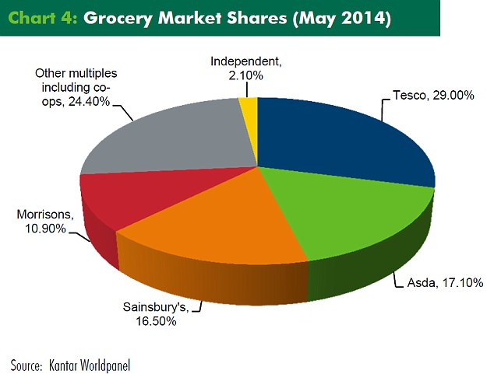
Market Share
Currently has a market share of around 28.4% in the the United Kingdom

Slide 5
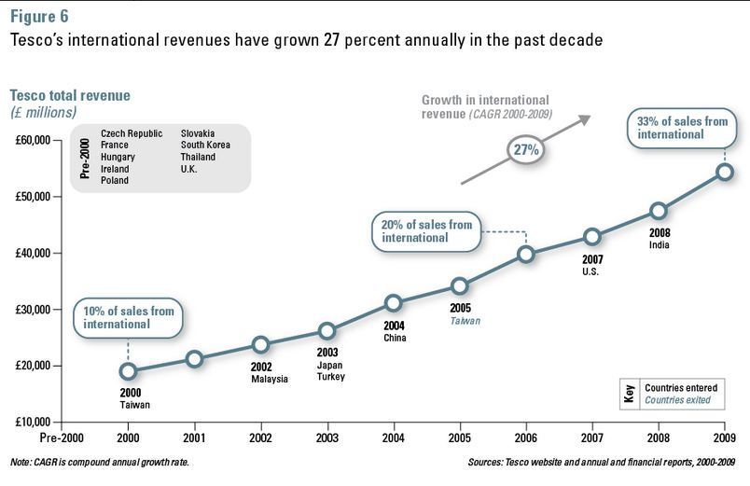

Slide 6
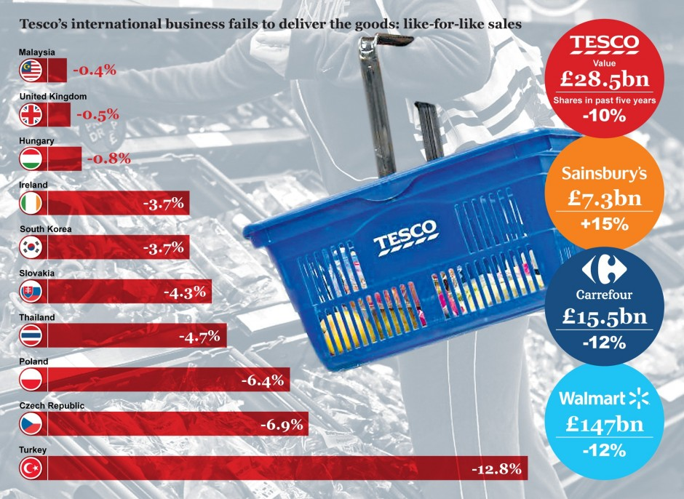
Sales !
Sales have dropped consistently for the past 2 years, with significant drops in the European region after its exit from the US market in 2013
http://internationalbusinessnewsweek.blogspot.in/2013/01/international-business-tesco.html

Slide 7
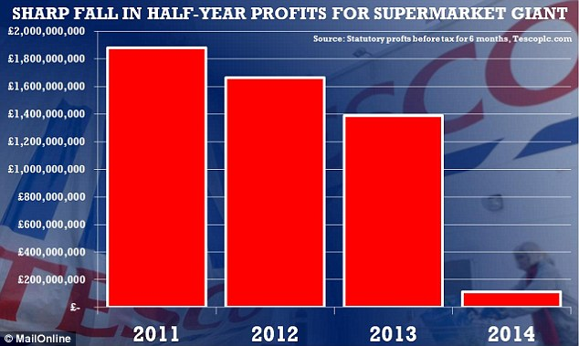
Sales !
Tesco sales fall at fastest rate for 20 years and share value plummets another £650 million in 2014.
http://www.dailymail.co.uk/news/article-2766306/Tesco-crisis-national-issue-affects-British-business-community-say-critics-supermarket-brings-new-finance-director-three-months-early.html

Slide 8
GROWTH STRATEGY:
In May 2011, Tesco committed £1 billion capital and revenue investment, and set out a seven part strategy to achieve goals of being highly valued by customers and long-term growth:
Grow the UK core business
increasing staff members by 20,000 in 2 years.
renovating existing stores
introducing more promotions
Be as strong in all products sold
develop its own label brands
provide customers with quality products at competitive prices
http://essentialmarketingplanning.blogspot.in/2011/05/tesco-7-step-strategy-for-growth.html
http://businesscasestudies.co.uk/tesco/vision-values-and-business-strategies/strategy.html#axzz3gy95dSxS

Slide 9
GROWTH STRATEGY:
Be an outstanding international retailer, in stores and online
In 2012, this generated 30% profits
opening new franchise in dif countries
Grow retailing services in all markets
potential for future growth in financial services
tesco bank generated 1 pound revenue in 2012
Put sustainability and responsibility to local communities at the heart of the business, through “3 Big Ambitions”
Reduce food waste globally
Improve health by providing customers with the information and choices to live healthier life.
To create new job opportunities
Build the employee team to be able to create more value for customers
Create highly valued brands that win and retain customer loyalty
http://essentialmarketingplanning.blogspot.in/2011/05/tesco-7-step-strategy-for-growth.html
http://businesscasestudies.co.uk/tesco/vision-values-and-business-strategies/strategy.html#axzz3gy95dSxS

Slide 10
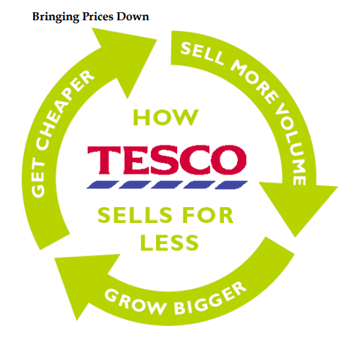

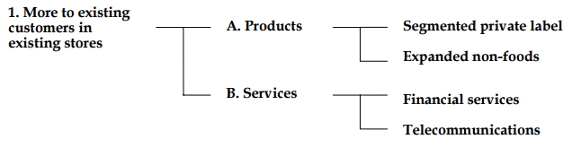
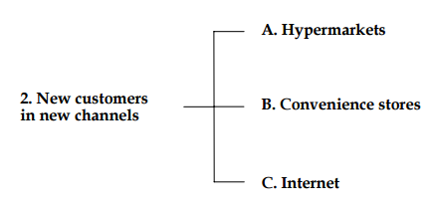

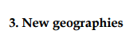
How to increase
sales?
Europe- France, Ireland, Central Europe, Turkey
Asia- South east Asia, North east Asia
http://www.coriolisresearch.com/pdfs/coriolis_tesco_study_in_excellence.pdf

Slide 11
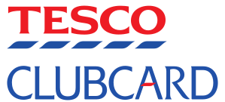
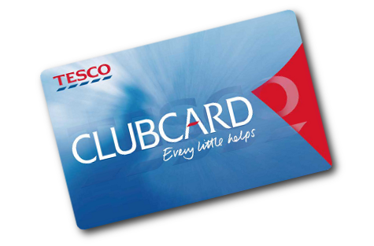
TESCO Clubcard was launched in 1995
Working-
Collect points every time you shop online, in-store or fill up the pump.
Get vouchers once you the clubcard has 150 points.
Spend or boost vouchers once you reach 150 points.
http://www.tesco.com/clubcard/

Slide 12
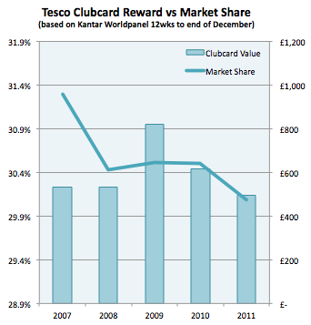
Tesco Club card

Slide 13
PROJECT ROLLING BALL:
Before clubcard Tesco had run Green Shield Stamps as a promotional tool which rewarded people for visits and spend but gained no customer information.
Grant Harrison(Head of first team for Clubcard) approached Clive Humby from marketing firm dunnhumby for help with the loyalty card project.
Harrison and Humby presented the strategy to the annual Board strategy session on the basis of pilot projects in 1994.
Seeing the loyalty program Tesco's then-Chairman Lord MacLaurin, said "What scares me about this is that you know more about my customers after three months than I know after 30 years."
https://en.wikipedia.org/wiki/Tesco_Clubcard

Slide 14
Green Clubcard points
When customers re-use bags when shopping in store or opt out of receiving bagged products when shopping online
They can also be earned by recycling products like mobile phones and ink cartridges, through Tesco-branded recycling services.
Clubcard Strategies
Clubcard Boost
With Clubcard Boost at Tesco, every £5 worth of Clubcard vouchers gets you £10 to spend on selected departments
Clubcard Fuel Save
Tesco launched a new money saving offer for fuel
Customers can earn up to 20p off every litre of fuel
Tesco Bank - earn points on financial services including loans, insurance and the Tesco Clubcard credit card
E.ON - earn Tesco Clubcard points on your gas and electricity bills.
Buy groceries online
Tesco Direct
Tesco Wine by the Case
F&F Clothing https://en.wikipedia.org/wiki/Tesco_Clubcard

Slide 15
SUCCESS OF LOYALTY PROGRAM
Tesco was able to predict consumer trends and react to them using the data collected through clubcards.
With the launch of Tesco Clubcard, Tesco created a mutually profitable relationship with its 15 million customers. After the launch, weekly sales increased 30%. And Tesco's market share doubled from 16.5% to over 35% in the first 13 years of the program.
During that time Tesco.com became the world's biggest and most successful online food retailer.
According to Tesco CEO, Sir Terry Leahy, "We could not have created the dot.com business without data from the loyalty card"
The CRM email strategy resulted in about 3000 customers being re-activated. Loyalty retention was also on the rise with about 30% increase in customer loyalty.
Tesco currently has 16.5 million active Clubcard users, and some of the customer feedbacks are-
One said: “Tesco Clubcard is great – I can treat my nieces to meals at Café Rouge at quarter price.”
Another said: “Free cinema tickets at the moment, and did I mention the £10-£15 worth of vouchers I get sent every month?”

Slide 16

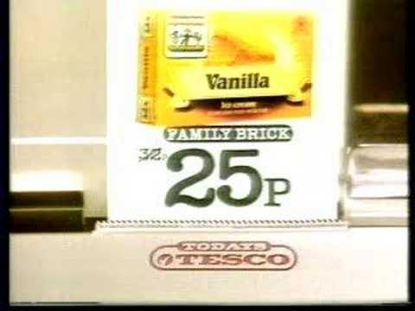
Other Major Marketing Strategies
"Checkout 82," which was made in 1982, where a till would have a receipt coming out of it with the prices on.

Slide 17
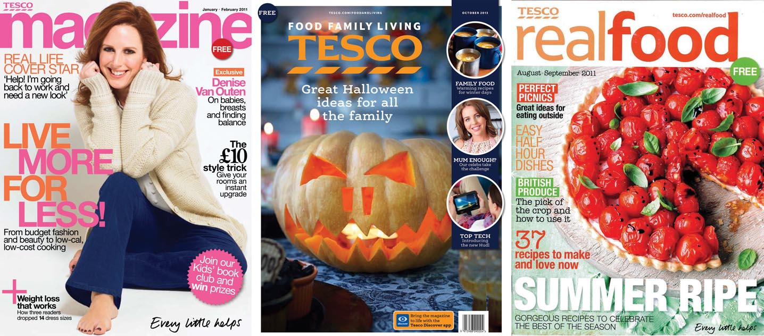
Other Major Marketing Strategies
Tesco magazine with a circulation of 1.9 million as of 2013 is Uks biggest food and lifestyle magazine

Slide 18
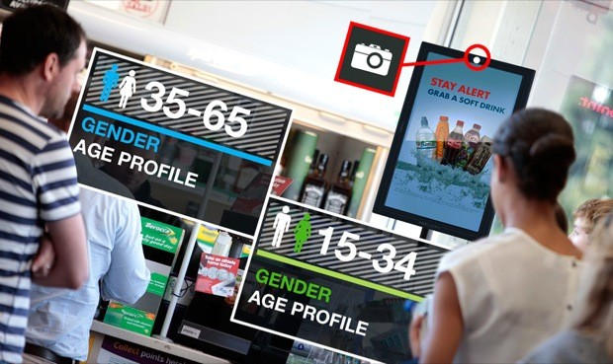
Other Major Marketing Strategies
Face-scanning technology
Installed in 450 gas stations across the U.K. to target customers
Determines your gender and approximate age while you wait in a line to pay
Show you more adverts when you might otherwise not be looking at adverts
Displays relevant customized adverts
https://en.wikipedia.org/wiki/Tesco
http://www.businessinsider.in/A-British-Gas-Station-Chain-Is-Installing-Creepy-Face-Scanning-Cameras-To-Track-
Consumers/articleshow/25275676.cms
http://www.theguardian.com/technology/2013/nov/04/tescos-face-scanning-system-the-key-questions-answered

Slide 19
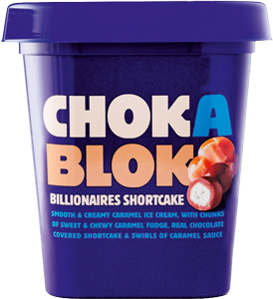
Other Major Marketing Strategies
Tesco venture brands
Tesco venture brands are an advanced form of private label brands launched by Tesco in 2011
Private-label products or services are typically those manufactured or provided by one company for offer under another company's brand

Slide 20
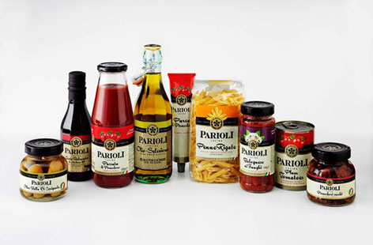
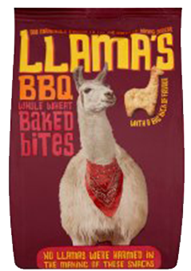
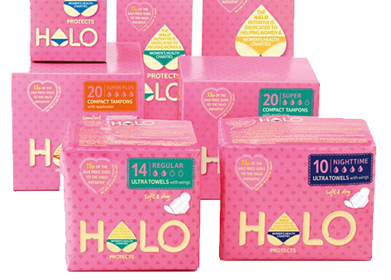
Other Major Marketing Strategies
Tesco venture brands
They entirely disconnect the store name (Tesco) from the product
Most of the brands are positioned as "premium goods" competing with existing premium branded goods
By creating a brand that is independent to the retailer, in terms of brand, can become a tool to target specific customer groups that do not favor the Tesco brand
https://en.wikipedia.org/wiki/Tesco_Venture_Brands

Slide 21
Recommendations
Tesco sales have been falling in the UK consistently for the past two years, with internet shopping becoming increasingly influential and more families turning to Aldi and Lidl, the two German chains. With Tesco losing market share, it could be time for the supermarket to be radical again. It could be time to start online clubcard.
Obsessed with the US- TESCO could have realised earlier to exit the US and probably could have ended up making less profits.
TESCO did not try to adapt itself according to the country and focussed too much on their once publicized “TESCO way”. Better adaptability to different regions could have helped them survive.
Lack of competitiveness to stay at the top after reaching their peak in terms of market share in 2009-10.
https://www.youtube.com/watch?v=hv4eEifsE08

Slide 22
Thank you

